Slide 1
Discussion 8
Transactions & Concurrency

Slide 2
Announcements
- Vitamin 8 (Xacts and Concurrency) is due Oct 28
- Vitamin 9 (Recovery) is due Nov 4
- MT2 review session
- MT2 is on Nov 7, 8-10pm

Slide 3
Agenda
Transactions
Serializability
Locking
Multi-granularity Locking
Worksheet

Slide 4
Transactions

Slide 5
Transactions
Collections of operations that are a single logical unit
e.g. swapping sections on CalCentral is a single logical operation, but consists of:
checking if the new section has space
removing student from old section
adding student to new section
We would like these components to all happen at once
don’t want another student to fill up new section after removing student from old section!

Slide 6
Transactions
We want transactions to obey ACID
atomicity: all operations in a transaction happen, or none of them
consistency: database consistency (unique constraints, etc) is maintained
isolation: should look like we only run 1 transaction at a time (even if we run multiple concurrently)
durability: once a transaction commits, it persists
commit: indicates successful transaction (save changes)
abort: indicates unsuccessful transaction (revert changes)

Slide 7
Transactions
In the context of swapping sections on Calcentral....
atomicity: either drop and add, or no change - shouldn’t drop student from old section then not add into new section!
consistency: make sure constraints like “student only enrolled in one section” are maintained
isolation: should look like we’re not making other changes at the same time - for example, enrolling Amy into section after dropping Carl but before adding Carl to new section
durability: once we say that we’ve made the change, student should not suddenly find themselves in old section later on!

Slide 8
Transactions
For this week, we’ll focus on isolation. Durability and atomicity will be covered in the future
isolation: should look like we only run 1 transaction at a time (even if we run multiple concurrently)

Slide 9
Concurrency
There are benefits to running many transactions concurrently (at the same time)
throughput argument: can increase processor/disk utilization (e.g. work on another transaction while one is busy waiting for data from disk) → more transactions done per second
latency argument: if we run lots of transactions at once, a long running transaction doesn’t cause short transactions to wait a long time to start → transactions may get finished faster
but we still want to maintain isolation!
Notes:
[can skip]

Slide 10
Serializability

Slide 11
Serializability
schedule: order in which we execute operations of a set of transactions
serial schedule: every transaction runs start to finish without any interleaving
We say two schedules are equivalent if:
They involve the same transactions
Each transaction has its operations in the same order
The final state after all the transactions is the same
Having isolation basically means having a schedule that is equivalent to a serial schedule (serializable)

Slide 12
Serializability
How do you check if a schedule is serializable?
You don’t - even checking if a schedule is view serializable (stronger condition than serializable - some serializable schedules are not view serializable) is NP-complete
We instead check if schedules are conflict serializable
Much stronger condition than serializable - lots of serializable schedules are not conflict serializable
but usually good enough

Slide 13
Conflict Serializability
Two operations in a schedule conflict if:
at least one operation is a write
they are performed by different transactions
they work on the same resource
Conflicts are essentially pairs of operations that we need to be careful about
T₁ | R(A) | R(B) |  |  | R(A)
T₂ |  |  | R(B) | W(B)

Slide 14
Conflict Serializability
Two operations in a schedule conflict if:
at least one operation is a write
they are on different transactions
they work on the same resource
Conflicts are essentially pairs of operations that we need to be careful about
stale read: T₁ uses old value of B - if reversed order, output may differ
T₁ | R(A) | R(B) |  |  | R(A)
T₂ |  |  | R(B) | W(B)

Slide 15
Conflict Serializability
Two schedules are conflict equivalent (and therefore equivalent) if every conflict is ordered the same way
two reads are not a conflict, so they can be ordered in any way
two operations in the same transaction do not conflict, because the order is fixed anyways
two operations on different resources are not a conflict, and can happen in any order
A schedule is conflict serializable if it is conflict equivalent to a serial schedule

Slide 16
Conflict Serializability
How do we check for conflict equivalence/serializability?
We build a dependency graph (precedence graph)
One node per transaction
If an operation in T_{i} conflicts with an operation in T_{j}, and the operation in T_{i} comes first, add an edge from T_{i} to T_{j}
T₁ | R(A) | R(B) |  |  | R(A)
T₂ |  |  | R(B) | W(B)
T₁
T₂

Slide 17
Conflict Serializability
To find equivalent schedules, do a topological sort of the graphs!
If all the arrows are in the same direction, the two schedules are conflict equivalent
A serial schedule’s graph looks like:
No cycles in a serial schedule’s dependency graph
Theorem: all conflict serializable schedules have an acyclic dependency graph
We can just check if graph has a cycle!
T₁
T₂
T₃
T₄
T₅
T₆

Slide 18
View Serializability
Conflict serializable cares about the order of blind writes
intermediate writes that are overwritten without an interleaving read
order of blind writes doesn’t actually matter for serializability
Two schedules are view equivalent if they are conflict equivalent, except for potentially reordering blind writes
A schedule is view serializable if it is view equivalent to a serial schedule
NP-complete to check…
Also doesn’t cover all serializable schedules!

Slide 19
View Serializability
How do we check for view equivalence/serializability?
Same initial reads
Transaction reads in the same initial value for X in both schedules
Same dependent reads
If transaction reads in a value X written by another transaction in one schedule, it also reads value of X written by same transaction in view equivalent schedule.
Same winning writes
Same transaction writes the final value of X in both schedules
Schedule 1
Schedule 2
T₁ | R(A) |  | W(A)
T₂ |  | W(A)
T₃ |  |  |  | W(A)
T₁ | R(A) | W(A)
T₂ |  |  | W(A)
T₃ |  |  |  | W(A)

Slide 20
View Serializability
Blind Writes: writes with no reads in between
Shown in the sequence of three writes in both schedules
How do we check for view equivalence/serializability?
Same initial reads
Same dependent reads
Same winning writes
Schedule 1
Schedule 2
T₁ | R(A) |  | W(A)
T₂ |  | W(A)
T₃ |  |  |  | W(A)
T₁ | R(A) | W(A)
T₂ |  |  | W(A)
T₃ |  |  |  | W(A)

Slide 21
View Serializability
How do we check for view equivalence/serializability?
Same initial reads
Transaction reads in the same initial value for X in both schedules
Same dependent reads
If transaction reads in a value X written by another transaction in one schedule, it also reads value of X written by same transaction in view equivalent schedule.
Same winning writes
Same transaction writes the final value of X in both schedules
Schedule 1
Schedule 2
T₁ | R(A) |  | W(A)
T₂ |  | W(A)
T₃ |  |  |  | W(A)
T₁ | R(A) | W(A)
T₂ |  |  | W(A)
T₃ |  |  |  | W(A)

Slide 22
View Serializability
How do we check for view equivalence/serializability?
Same initial reads
Transaction reads in the same initial value for X in both schedules
Same dependent reads
If transaction reads in a value X written by another transaction in one schedule, it also reads value of X written by same transaction in view equivalent schedule.
Same winning writes
Same transaction writes the final value of X in both schedules
Schedule 1
Schedule 2
T₁ | R(A) |  | W(A)
T₂ |  | W(A)
T₃ |  |  |  | W(A)
T₁ | R(A) | W(A)
T₂ |  |  | W(A)
T₃ |  |  |  | W(A)

Slide 23
Types of Serializability
All Schedules
Serializable
View Serializable
Conflict Serializable
Serial

Slide 24
Phantom Problem
Phantom problem: occurs within a single transaction when the same query produces different sets of rows at different times
example: T1 executes SELECT twice, but returns a row the second time that was not returned the first time because T2 inserts a new value between the two SELECT statements → “phantom” row
these types of schedules are not serializable

Slide 25
Serializability Summary
Serial: schedule occurs in isolation (as if it’s the only one running)
Serializable: schedule appears to occur as if in isolation (looks equivalent to a serial schedule)
Conflict Serializable: All conflicting operations are ordered in the same way as that of a serial schedule
What we focus on in this course!
Conflict serializability implies serializability
View Serializable: All conflicts are conflict equivalent (just like conflict serializable) to a serial schedule but blind writes may appear in any order

Slide 26
Question 1
Conflict Serializability

Slide 27
Conflict Serializability
T₁ |  | R(A) | W(A) | R(B)
T₂ |  |  |  |  | W(B) | R(C) | W(C) | W(A)
T₃ | R(C) |  |  |  |  |  |  |  | W(D)
(a) Draw the dependency graph (precedence graph) for the schedule.

Slide 28
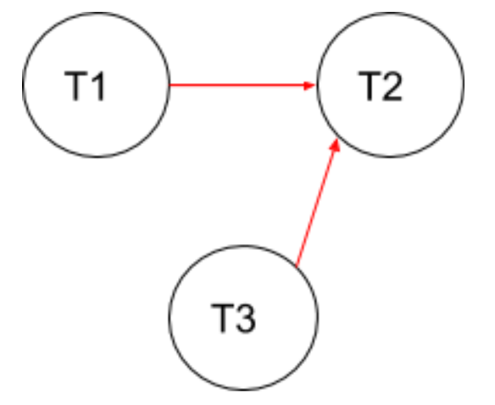
Conflict Serializability
T₁ |  | R(A) | W(A) | R(B)
T₂ |  |  |  |  | W(B) | R(C) | W(C) | W(A)
T₃ | R(C) |  |  |  |  |  |  |  | W(D)
(a) Draw the dependency graph (precedence graph) for the schedule.

Slide 29
Conflict Serializability
T₁ |  | R(A) | W(A) | R(B)
T₂ |  |  |  |  | W(B) | R(C) | W(C) | W(A)
T₃ | R(C) |  |  |  |  |  |  |  | W(D)
(b) Is this schedule conflict serializable? If so, what are all the conflict equivalent serial schedules? If not, why not?

Slide 30
Conflict Serializability
T₁ |  | R(A) | W(A) | R(B)
T₂ |  |  |  |  | W(B) | R(C) | W(C) | W(A)
T₃ | R(C) |  |  |  |  |  |  |  | W(D)
(b) Is this schedule conflict serializable? If so, what are all the conflict equivalent serial schedules? If not, why not?
Conflict equivalent to T₃ , T₁ , T₂ and T₁ , T₃ , T₂
(possible topological sorts of the dependency graph).

Slide 31
Conflict Serializability
T₁ | R(A) |  | R(B) |  |  |  | W(A)
T₂ |  | R(A) |  | R(B) |  |  |  | W(B)
T₃ |  |  |  |  | R(A)
T₄ |  |  |  |  |  | R(B)
(c) Draw the dependency graph (precedence graph) for the schedule.
Notes:
[can skip]

Slide 32
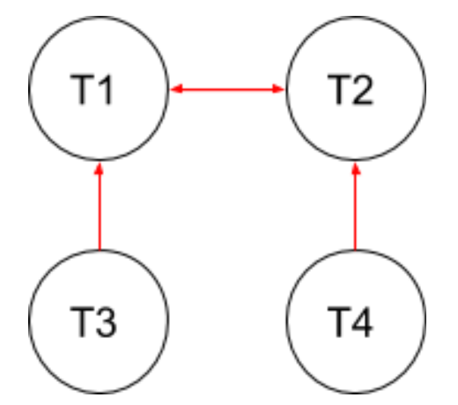
Conflict Serializability
T₁ | R(A) |  | R(B) |  |  |  | W(A)
T₂ |  | R(A) |  | R(B) |  |  |  | W(B)
T₃ |  |  |  |  | R(A)
T₄ |  |  |  |  |  | R(B)
(c) Draw the dependency graph (precedence graph) for the schedule.
Notes:
[can skip]

Slide 33
Conflict Serializability
T₁ | R(A) |  | R(B) |  |  |  | W(A)
T₂ |  | R(A) |  | R(B) |  |  |  | W(B)
T₃ |  |  |  |  | R(A)
T₄ |  |  |  |  |  | R(B)
(d) Is this schedule conflict serializable? If so, what are all the conflict equivalent serial schedules? If not, why not?
Notes:
[can skip]

Slide 34
Conflict Serializability
T₁ | R(A) |  | R(B) |  |  |  | W(A)
T₂ |  | R(A) |  | R(B) |  |  |  | W(B)
T₃ |  |  |  |  | R(A)
T₄ |  |  |  |  |  | R(B)
(d) Is this schedule conflict serializable? If so, what are all the conflict equivalent serial schedules? If not, why not?
No, there’s a cycle between T₁ and T₂ in the dependency graph.
Notes:
[can skip]

Slide 35
Locking

Slide 36
Simple Locking
Database operations tend to include more reads than writes, so we use readers-writers locks
A transaction may lock a resource in one of two ways: Shared or eXclusive, corresponding to reading and writing
An S lock lets a transaction read a resource (e.g. tuple)
Many transactions can hold S locks on a resource at once
An X lock lets a transaction modify a resource
No other transaction can have any type of lock while a transaction has an X lock
If a transaction can’t get a lock it wants, it blocks, and waits until another transaction releases the conflicting lock

Slide 37
Simple Locking
The lock compatibility matrix tells us whether multiple transactions can acquire locks on the same resource at the same time
Consider (S,X) = false. This means that it is not possible for T₁ to hold an S lock on a resource while T₂ holds an X lock on the same resource.
 | NL (no lock held) | S | X
NL (no lock held) | ✔ | ✔ | ✔
S | ✔ | ✔ | ❌
X | ✔ | ❌ | ❌
Notes:
Interpret the matrix as: Axis 1 is T1, axis 2 is T2.

Slide 38
Deadlocks
What if T₁ is waiting for T₂ to release a lock, but T₂ is also waiting for T₁ to release a lock?
This is called a deadlock - when a bunch of transactions are waiting on each other in a cycle
If T1 is waiting for T2 to release a lock, T1 cannot do any more operations or acquire more locks while it is waiting
We can either avoid them in the first place (deadlock avoidance) or catch them (deadlock detection) and abort a transaction in the deadlock

Slide 39
Deadlock Avoidance
Two approaches
wait-die: if transaction T_{i} wants a lock but T_{j} holds a conflicting lock
if T_{i} is higher priority, it waits for T_{j} to release conflicting lock
if T_{i} is lower priority, it aborts (“die”)
transactions can only wait on lower priority transactions → cannot have deadlock (lowest priority transactions cannot wait)
wound-wait: if transaction T_{i} wants a lock but T_{j} holds a conflicting lock
if T_{i} is higher priority, it causes T_{j} to abort (“wound”)
if T_{i} is lower priority, it waits for T_{j} to finish
transactions can only wait on higher priority transactions → cannot have deadlock (highest priority transactions cannot wait)

Slide 40
Deadlock Avoidance
Unless priority is explicitly defined, assign a transaction’s priority by age: now - start time
While T₁ waits for T₂ to release a lock, T₁ cannot do any more operations or acquire other locks

Slide 41
Deadlock Detection
We draw out a “waits-for” graph
One node for each transaction
If T_{i} holds a lock that conflicts with the lock that T_{j} wants (or T_{j} “waits for” T_{i}), we add an edge from T_{j} to T_{i}
A cycle indicates a deadlock (between the transactions in the cycle) - we can abort one to end the deadlock
Alternative approach (used in some real databases): just kill transactions if they aren’t doing anything for a while
T_{j}
T_{i}

Slide 42
Question 2
Deadlocks

Slide 43
Deadlocks
T₁ | S(A) | S(D) |  | S(B)
T₂ |  |  | X(B) |  |  |  | X(C)
T₃ |  |  |  |  | S(D) | S(C) |  |  | X(A)
T₄ |  |  |  |  |  |  |  | X(B)
(a) Draw a “waits-for” graph and state whether or not there is a deadlock.

Slide 44
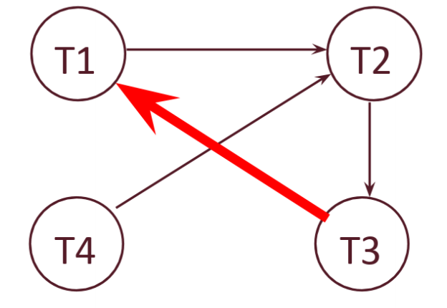
Deadlocks
T₁ | S(A) | S(D) |  | S(B)
T₂ |  |  | X(B) |  |  |  | X(C)
T₃ |  |  |  |  | S(D) | S(C) |  |  | X(A)
T₄ |  |  |  |  |  |  |  | X(B)
(a) Draw a “waits-for” graph and state whether or not there is a deadlock.
Deadlock between T₁ , T₂ , T₃ .

Slide 45
Deadlocks
(b) If we try to avoid deadlock by using wait-die deadlock avoidance policy, would any transactions be aborted? Assume T1 priority > T2 > T3 > T4.
T₁ | S(A) | S(D) |  | S(B)
T₂ |  |  | X(B) |  |  |  | X(C)
T₃ |  |  |  |  | S(D) | S(C) |  |  | X(A)
T₄ |  |  |  |  |  |  |  | X(B)

Slide 46
Deadlocks
(b) If we try to avoid deadlock by using wait-die deadlock avoidance policy, would any transactions be aborted? Assume T1 priority > T2 > T3 > T4. Yes, T3 and T4 are aborted. When T4 attempts to acquire a lock on B, which is held by T2, T4 will abort since it is attempting to acquire a lock held by a transaction with higher priority. The same thing happens when T3 attempts to acquire a lock on A, which is held by T1.
T₁ | S(A) | S(D) |  | S(B)
T₂ |  |  | X(B) |  |  |  | X(C)
T₃ |  |  |  |  | S(D) | S(C) |  |  | X(A)
T₄ |  |  |  |  |  |  |  | X(B)

Slide 47
Locking (2PL and Strict 2PL)

Slide 48
2-Phase Locking (2PL)
One way to enforce conflict serializability
In 2-phase locking,
a transaction may not acquire a lock after it has released any lock
two “phases”
from start to until a lock is released, the transaction is only acquiring locks
then until the end of the transaction, it is only releasing locks
acquisition phase
release phase
# locks held
time

Slide 49
Cascading Aborts
Consider the following (+ for acquire, - for release):
T₁ aborting means all of the transactions have to be rolled back
Even though T₄ and T₅ didn’t read A at all
This is a cascading abort
T₁ | +X(A) | -X(A) |  |  |  |  |  | abort!
T₂ |  |  | +S(A)
T₃ |  |  | +S(A) | +X(B) | -X(B)
T₄ |  |  |  |  |  | +S(B)
T₅ |  |  |  |  |  |  | +S(B)

Slide 50
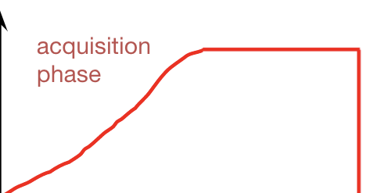
Strict 2-Phase Locking (Strict 2PL)
The problem is that 2PL lets another transaction read new values before the transaction commits (since locks can be released long before commit)
Strict 2PL avoids cascading aborts
Same as 2PL, except only allow releasing locks at end of transaction
# locks held
release all locks at end of xact
time

Slide 51
Strict 2PL and Cascading Aborts
The previous schedule would have been illegal under Strict 2PL
T₁ would not release its lock on A until it commits
Other transactions would not have seen A and would not have to be rolled back
T₁ | +X(A) | -X(A) |  |  |  |  |  | abort!
T₂ |  |  | +S(A)
T₃ |  |  | +S(A) | +X(B) | -X(B)
T₄ |  |  |  |  |  | +S(B)
T₅ |  |  |  |  |  |  | +S(B)

Slide 52
Question 3
Locking

Slide 53
Locking
T₁ | T₂
Lock X(B)
Read B
B := B * 10
Write B
Lock X(F)
Unlock B
 | Lock S(F)
F := B * 100
Write F
Commit
Unlock F
 | Read F
 | Unlock F
 | Lock S(B)
 | Read B
 | Print F+B
 | Commit
 | Unlock B
(a) What is printed, assuming we initially have B = 3 and F = 300?

Slide 54
Locking
T₁ | T₂
Lock X(B)
Read B
B := B * 10
Write B
Lock X(F)
Unlock B
 | Lock S(F)
F := B * 100
Write F
Commit
Unlock F
 | Read F
 | Unlock F
 | Lock S(B)
 | Read B
 | Print F+B
 | Commit
 | Unlock B
(a) What is printed, assuming we initially have B = 3 and F = 300?
3030
T1: Lock X(B) → Read B → B = 3*10 = 30 → Write B → Lock X(F) → Unlock B
T2: Lock S(F) (waiting for T1 to release X Lock on F)
T1: F = 30*100 = 3000 → Write F → Commit → Unlock F (S Lock on F is granted to T2)
T2: Read F → Unlock F → Lock S(B) → Read B → Compute and print F + B = 3000 + 30 = 3030 → Commit → Unlock B

Slide 55
Locking
T₁ | T₂
Lock X(B)
Read B
B := B * 10
Write B
Lock X(F)
Unlock B
 | Lock S(F)
F := B * 100
Write F
Commit
Unlock F
 | Read F
 | Unlock F
 | Lock S(B)
 | Read B
 | Print F+B
 | Commit
 | Unlock B
(b) Does the execution use 2PL, strict 2PL, or neither?

Slide 56
Locking
T₁ | T₂
Lock X(B)
Read B
B := B * 10
Write B
Lock X(F)
Unlock B
 | Lock S(F)
F := B * 100
Write F
Commit
Unlock F
 | Read F
 | Unlock F
 | Lock S(B)
 | Read B
 | Print F+B
 | Commit
 | Unlock B
(b) Does the execution use 2PL, strict 2PL, or neither?
Neither - S(F) unlocked before T₂ acquires S(B)

Slide 57
Locking
T₁ | T₂
Lock X(B)
Read B
B := B * 10
Write B
Lock X(F)
Unlock B
 | Lock S(F)
F := B * 100
Write F
Commit
Unlock F
 | Read F
 | Unlock F
 | Lock S(B)
 | Read B
 | Print F+B
 | Commit
 | Unlock B
(c) Would moving Unlock F in T₂ to any point after Lock S(B) change this (or keep it) in 2PL?

Slide 58
Locking
T₁ | T₂
Lock X(B)
Read B
B := B * 10
Write B
Lock X(F)
Unlock B
 | Lock S(F)
F := B * 100
Write F
Commit
Unlock F
 | Read F
 | Unlock F
 | Lock S(B)
 | Read B
 | Print F+B
 | Commit
 | Unlock B
(c) Would moving Unlock F in T₂ to any point after Lock S(B) change this (or keep it) in 2PL?
Yes - all locks would be acquired (for T₂) before any are released.

Slide 59
Locking
T₁ | T₂
Lock X(B)
Read B
B := B * 10
Write B
Lock X(F)
Unlock B
 | Lock S(F)
F := B * 100
Write F
Commit
Unlock F
 | Read F
 | Unlock F
 | Lock S(B)
 | Read B
 | Print F+B
 | Commit
 | Unlock B
(d) Would moving Unlock F in T₁ and Unlock F in T₂ to the end of their respective transactions change this (or keep it) in strict 2PL?
Notes:
[can skip]

Slide 60
Locking
T₁ | T₂
Lock X(B)
Read B
B := B * 10
Write B
Lock X(F)
Unlock B
 | Lock S(F)
F := B * 100
Write F
Commit
Unlock F
 | Read F
 | Unlock F
 | Lock S(B)
 | Read B
 | Print F+B
 | Commit
 | Unlock B
(d) Would moving Unlock F in T₁ and Unlock F in T₂ to the end of their respective transactions change this (or keep it) in strict 2PL?
No - T₁ still unlocks B before the end of the transaction
Notes:
[can skip]

Slide 61
Locking
T₁ | T₂
Lock X(B)
Read B
B := B * 10
Write B
Lock X(F)
Unlock B
 | Lock S(F)
F := B * 100
Write F
Commit
Unlock F
 | Read F
 | Unlock F
 | Lock S(B)
 | Read B
 | Print F+B
 | Commit
 | Unlock B
(e) Would moving Unlock B in T₁ and Unlock F in T₂ to the end of their respective transactions change this (or keep it) in strict 2PL?

Slide 62
Locking
T₁ | T₂
Lock X(B)
Read B
B := B * 10
Write B
Lock X(F)
Unlock B
 | Lock S(F)
F := B * 100
Write F
Commit
Unlock F
 | Read F
 | Unlock F
 | Lock S(B)
 | Read B
 | Print F+B
 | Commit
 | Unlock B
(e) Would moving Unlock B in T₁ and Unlock F in T₂ to the end of their respective transactions change this (or keep it) in strict 2PL?
Yes - all unlocks would only happen when the respective transactions end

Slide 63
Multi-granularity Locking

Slide 64
Multi-granularity Locking
What are the granularity of our locks?
Tuple-level: one lock per tuple, but then a scan might lock millions of locks → high locking overhead
Table-level: one lock per table, but then any update locks the entire table → low concurrency
Multi-granularity locking: instead of picking one, allow for locking at different levels of granularity (e.g. database, table, page, tuple)
scans can acquire a lock for entire table → low overhead
updating tuple can acquire a lock for tuple only → high concurrency

Slide 65
Multi-granularity Locking
If a transaction has X on a tuple, it shouldn’t be possible to get S on the entire table
checking locks on all tuples → high locking overhead again
For each lock, require that transactions hold appropriate intent locks at all higher levels of granularity
need an intent lock on database, table, page to hold S/X lock on tuple
intent lock tells us about any potential locking at a lower level

Slide 66
Multi-granularity Locking
Two new lock types:
IS = Intent to acquire Shared lock at a lower level
IX = Intent to acquire eXclusive lock at a lower level
Require that a transaction has IS to acquire S, IX to acquire X
To get S(tuple), need: IS(database), IS(table), IS(page)
IX lets you acquire S/IS locks too
If a transaction tries to get S(table), and sees another transaction has IX(table) → another transaction has X lock on a tuple, so we can’t get S(table) yet

Slide 67
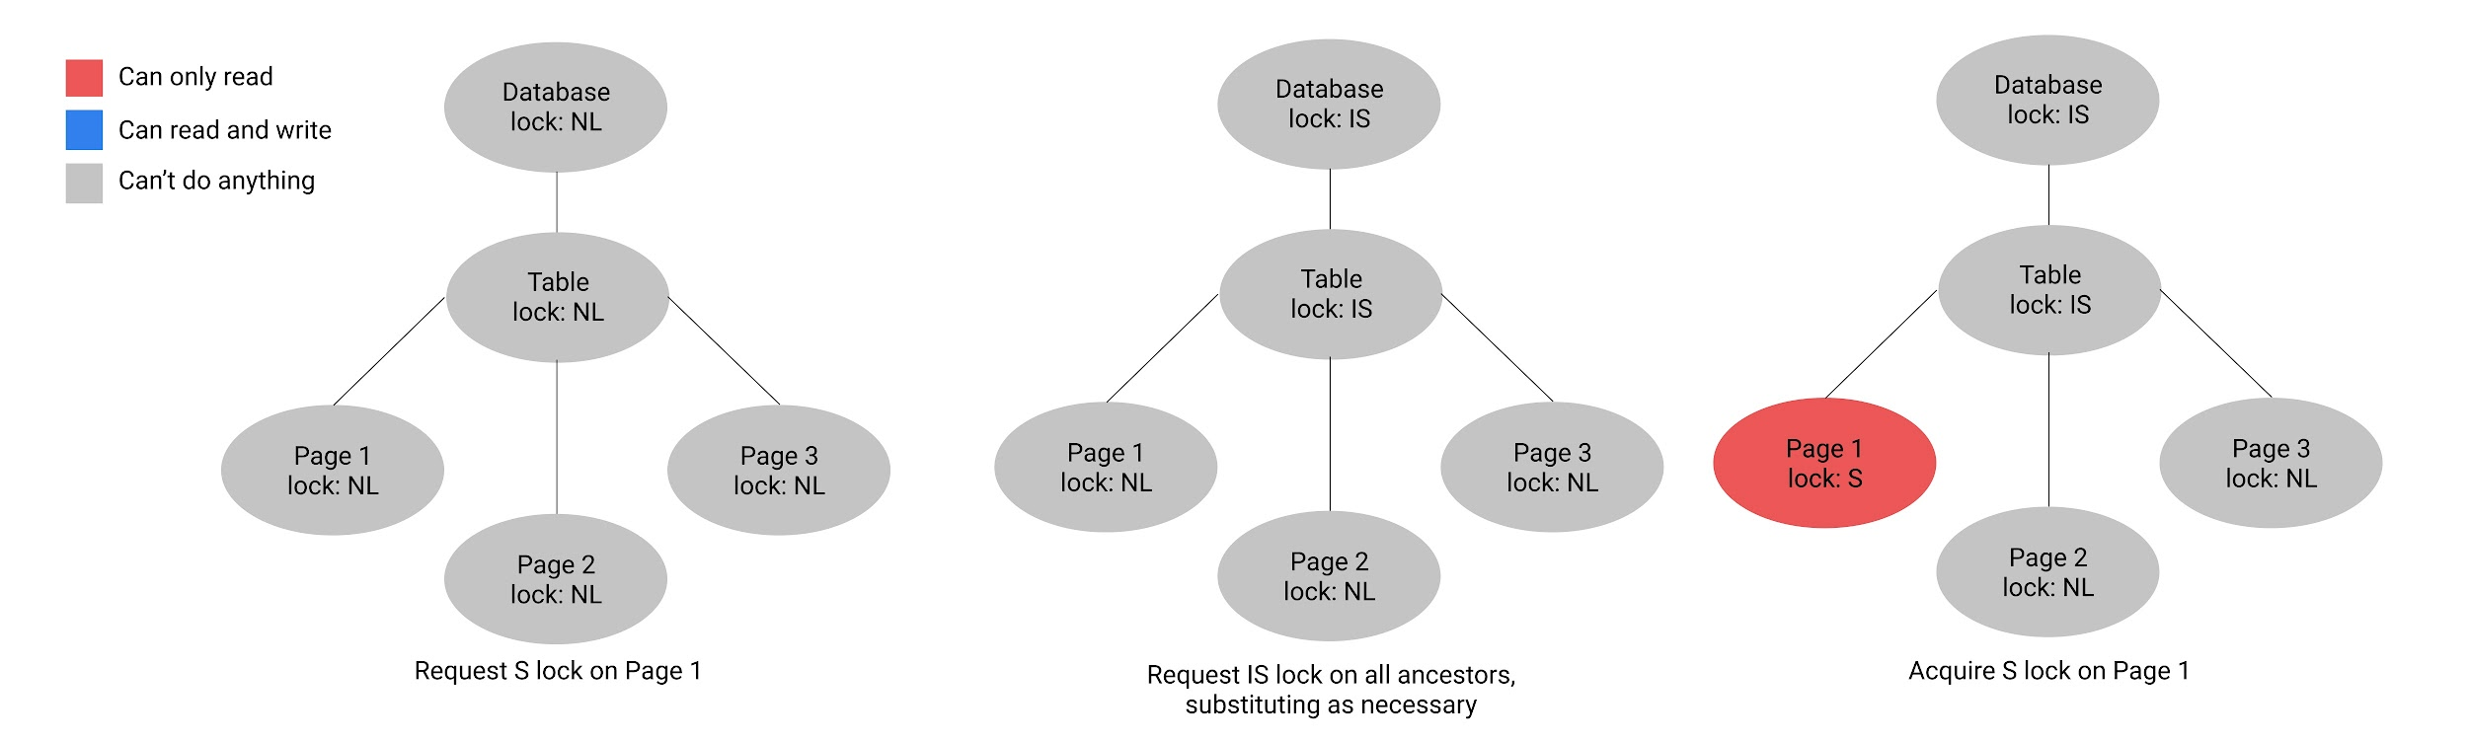
Multi-granularity Locking

Slide 68
Multi-granularity Locking
What if we want to scan table AND update a page?
X on entire table → low concurrency
IX on table, S/X locks on every page → high locking overhead
One more lock type:
SIX = Shared + Intent to acquire eXclusive lock at a lower level
Basically equivalent to having both S and IX locks – can read entire table, can also acquire X locks

Slide 69
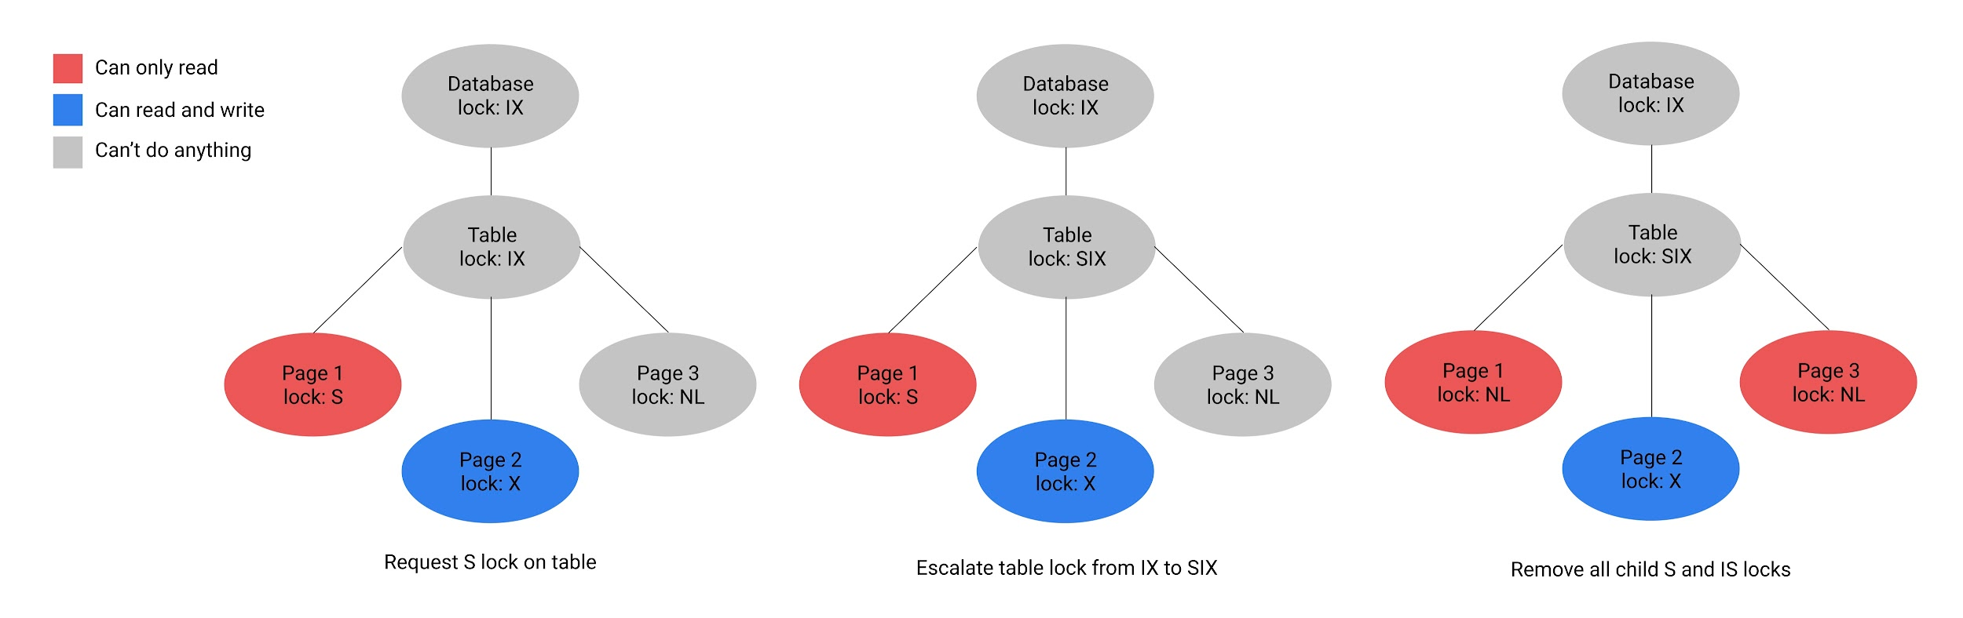
Multi-granularity Locking

Slide 70
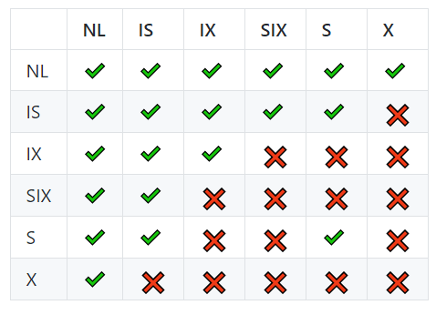
Multi-granularity Locking
Our new compatibility matrix
Notes:
Try to reason about why each pair is the way it is - should be able to figure out entire matrix without having it written down for reference

Slide 71
Multi-granularity Locking
Parent → Children Lock Relationships for a Single Transaction
Parent Lock | Possible Children Locks
NL | Nothing
S | Nothing
X | Nothing
IS | IS, S
IX | IX, X, IS, S
SIX | IX, X

Slide 72
Question 4
Multi-granularity Locking

Slide 73
Multi-granularity Locking
(a) Suppose a transaction T₁ wants to scan a table R and update a few of its tuples. What kinds of locks should T₁ have on R, the pages of R, and the updated tuples?
Notes:
[can skip]

Slide 74
Multi-granularity Locking
(a) Suppose a transaction T₁ wants to scan a table R and update a few of its tuples. What kinds of locks should T₁ have on R, the pages of R, and the updated tuples?
SIX on R
IX on page (no need for SIX since already have S on R)
X on tuples being modified
Notes:
[can skip]

Slide 75
Multi-granularity Locking
(b) Is an S lock compatible with an IX lock?
Notes:
[can skip]

Slide 76
Multi-granularity Locking
(b) Is an S lock compatible with an IX lock?
Suppose T₁ wants S(A) and T₂ wants IX(A).
S(A) implies T₁ will read all of A.
IX(A) implies T₂ will write to some of A.
We can’t have T₁ read all of A while T₂ is writing to some of it, so S and IX are incompatible.
Notes:
[can skip]

Slide 77
Multi-granularity Locking
(c) Consider a table which contains two pages with three tuples each, with Page 1 containing Tuples 1, 2, and 3, and Page 2 containing Tuples 4, 5, and 6.
Given that a transaction T₁ has IX(table), IX(Page 1), X(Tuple 1), which locks can be granted to a second transaction T₂ on Tuple 2?
Table
Lock: IX
T₁: Red
T₂: Blue
Page 1
Lock: IX
Page 2
Lock:
Tuple 1
Lock: X
Tuple 2
Lock: ?
Tuple 3
Lock:
Tuple 4
Lock:
Tuple 5
Lock:
Tuple 6
Lock:

Slide 78
Multi-granularity Locking
(c) Consider a table which contains two pages with three tuples each, with Page 1 containing Tuples 1, 2, and 3, and Page 2 containing Tuples 4, 5, and 6.
Given that a transaction T₁ has IX(table), IX(Page 1), X(Tuple 1), which locks can be granted to a second transaction T₂ on Tuple 2?
X, S

Slide 79
Multi-granularity Locking
(c) Consider a table which contains two pages with three tuples each, with Page 1 containing Tuples 1, 2, and 3, and Page 2 containing Tuples 4, 5, and 6.
Given that a transaction T₁ has IS(table), S(Page 1), which locks can be granted to a second transaction T₂ on Page 1?
Table
Lock: IS
T₁: Red
T₂: Blue
Page 1
Lock: S, ?
Page 2
Lock:
Tuple 1
Lock:
Tuple 2
Lock:
Tuple 3
Lock:
Tuple 4
Lock:
Tuple 5
Lock:
Tuple 6
Lock:

Slide 80
Multi-granularity Locking
(c) Consider a table which contains two pages with three tuples each, with Page 1 containing Tuples 1, 2, and 3, and Page 2 containing Tuples 4, 5, and 6.
Given that a transaction T₁ has IS(table), S(Page 1), which locks can be granted to a second transaction T₂ on Page 1?
S, IS

Slide 81

Attendance Link
https://cs186berkeley.net/attendance

